Slide 1



About Izzi
Telecommunications company in Mexico.
Main services:
Cable Television
Broadband Internet
Fixed-line Telephone
Mobile Phone Services

Slide 2












About Izzi
Telecommunications company in Mexico.
Main services:
Cable Television
Broadband Internet
Fixed-line Telephone
Mobile Phone Services

Slide 3

Our App-roach
Telephony
Internet
Television

Slide 4




Slide 5

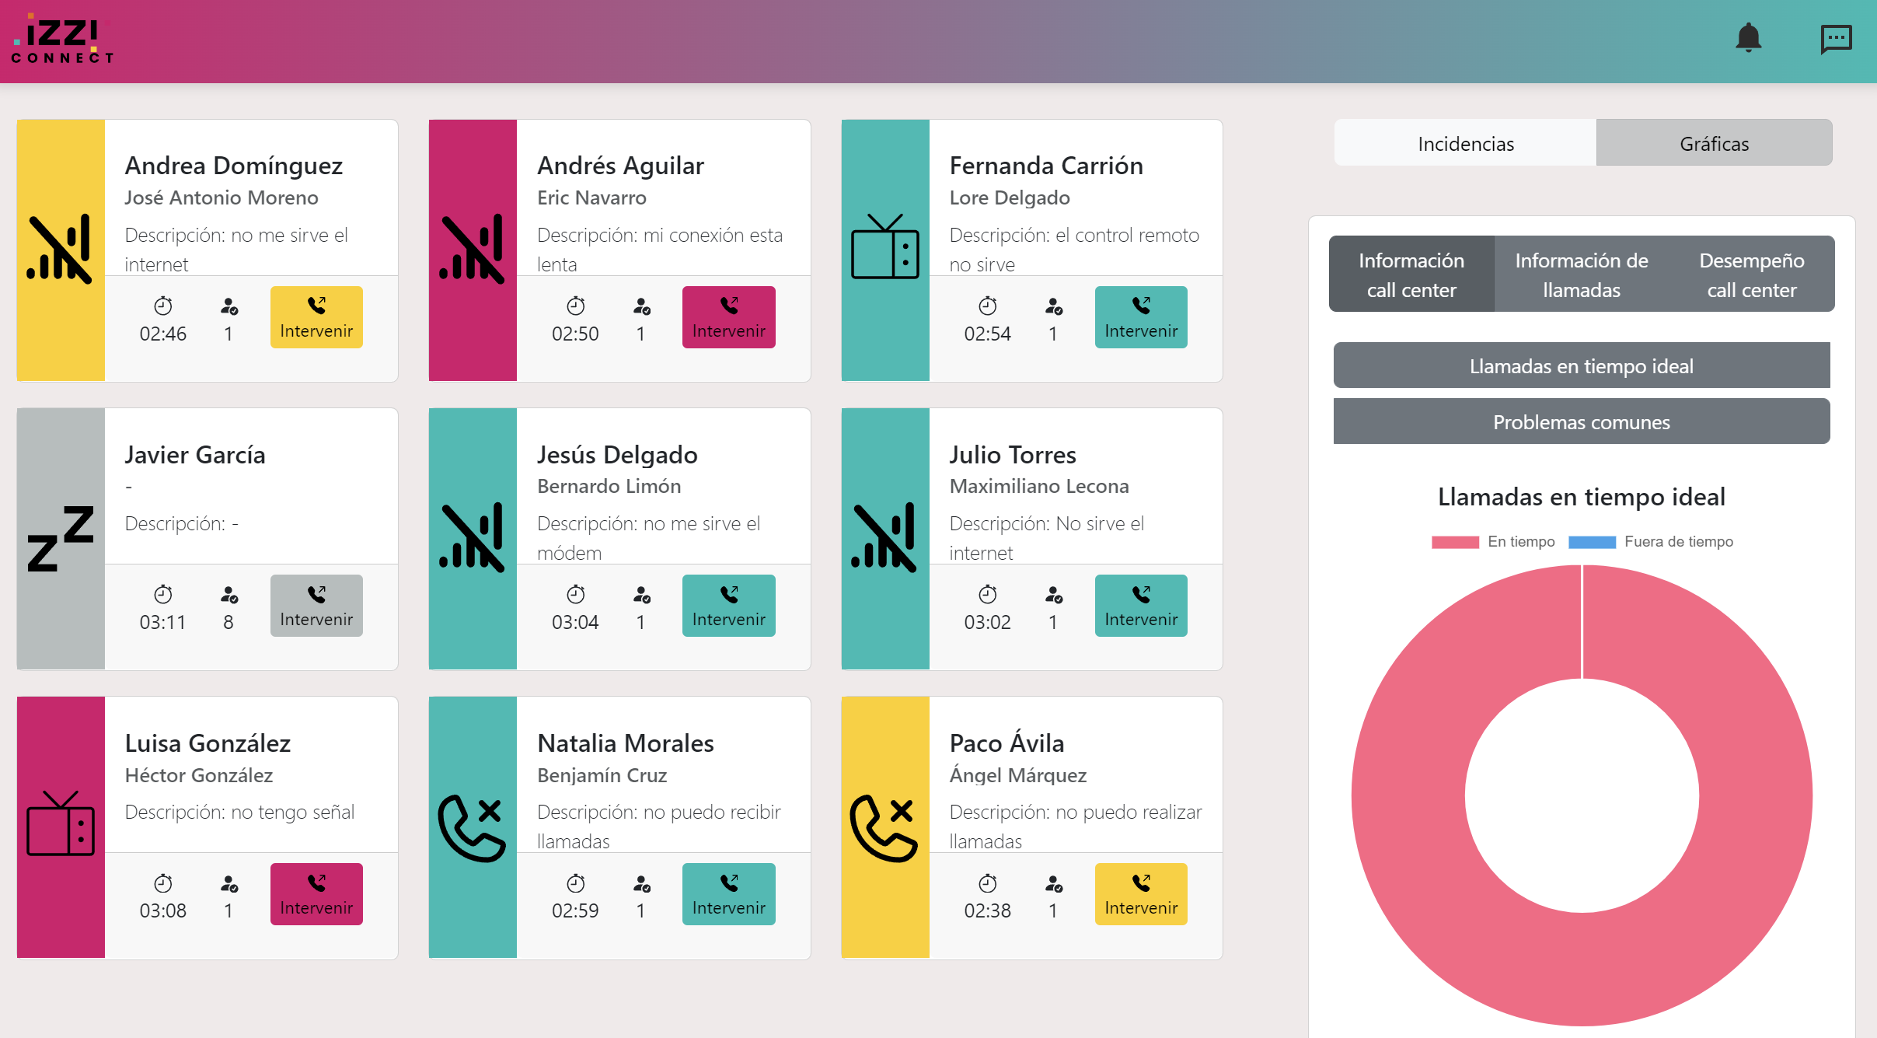
What you requested
Agent insights to supervisors
Enabling supervisors to gain detailed info unto agent performance
Responsive web application
To ensure the apps work seamlessly across all devices
Real-time metrics
Providing real-time performance metrics
Sentiment Analysis
To provide valuable insights
Performance-based suggestions
To enhance service quality

Slide 6
Our extra touch ...
Personalized IVR
Implementing a personalized IVR and maintaining detailed client interaction history
​
Two applications
Two specialized apps to meet diverse operational needs and improve overall functionality
​
Real time interactions
Providing real-time transcription of client interactions enabling quick reference
​
Client history
Forecasting future service demands based on historical data

Slide 7









Lambda
SNS
IAM / Cognito
ChatBot
Lex
RDS
Cloudwatch
Connect

Slide 8
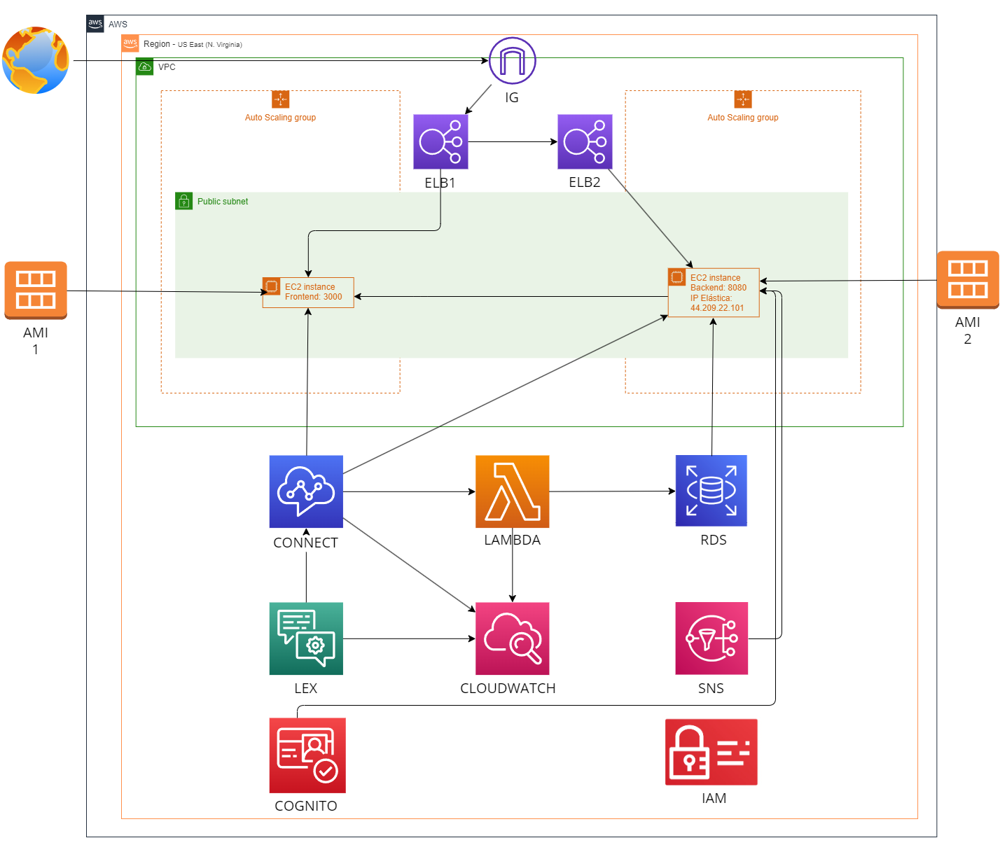

Slide 10

Before we start…

Slide 11

Welcome to Izzi's Technical Support Contact Center, where we will provide you with the appropriate service for your needs.
Please tell us about the issue you are experiencing with the Internet, Phone, or TV services.

Slide 12

Welcome to Izzi's Technical Support Contact Center, where we will provide you with the appropriate service for your needs.
Please tell us about the issue you are experiencing with the Internet, Phone, or TV services.
I'm having several troubles with my internet

Slide 13
Would you kindly answer the following question?
On a scale of one to three, with three being the highest rating, how would you rate the quality of the call?
Thank you for completing the survey, goodbye.

Slide 14

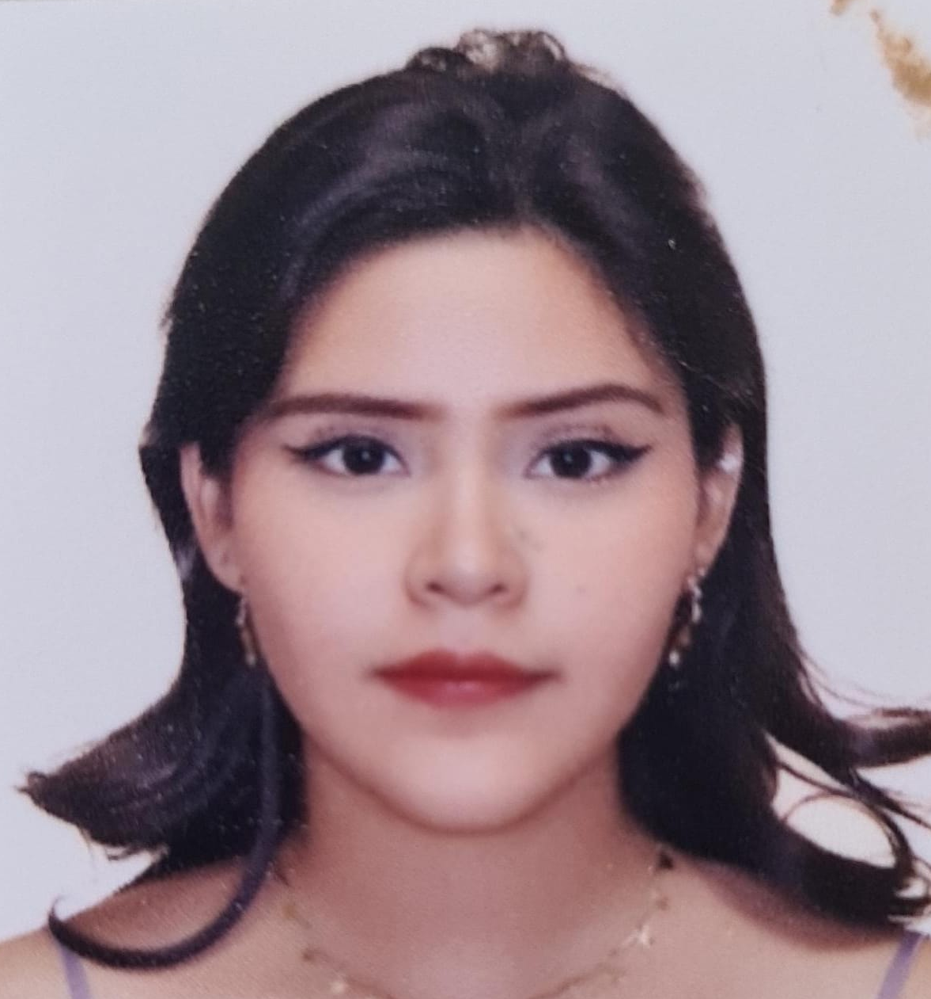
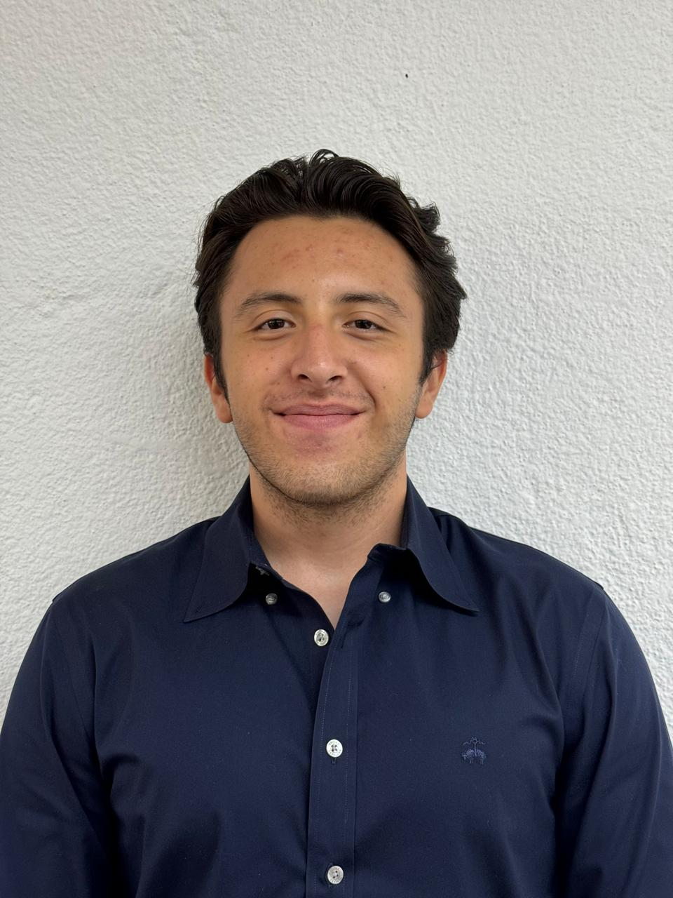
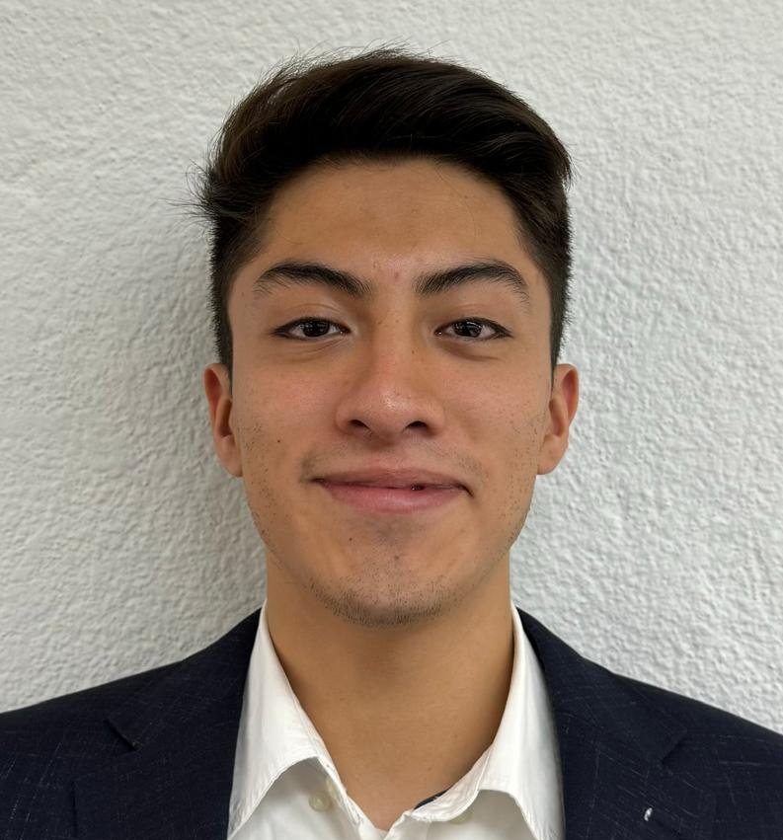
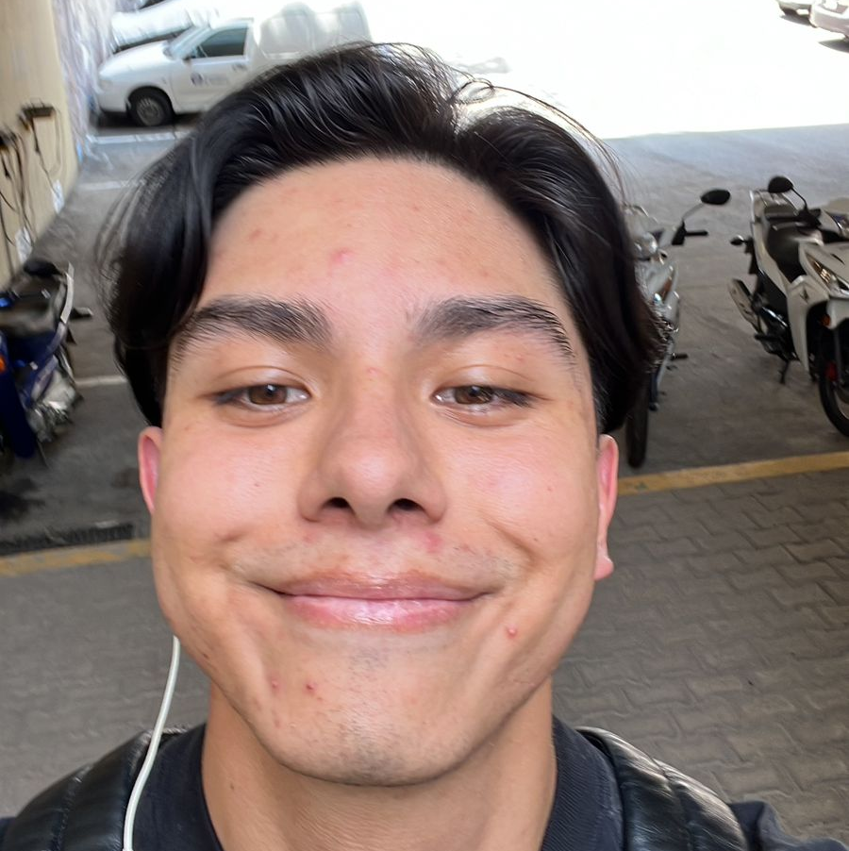
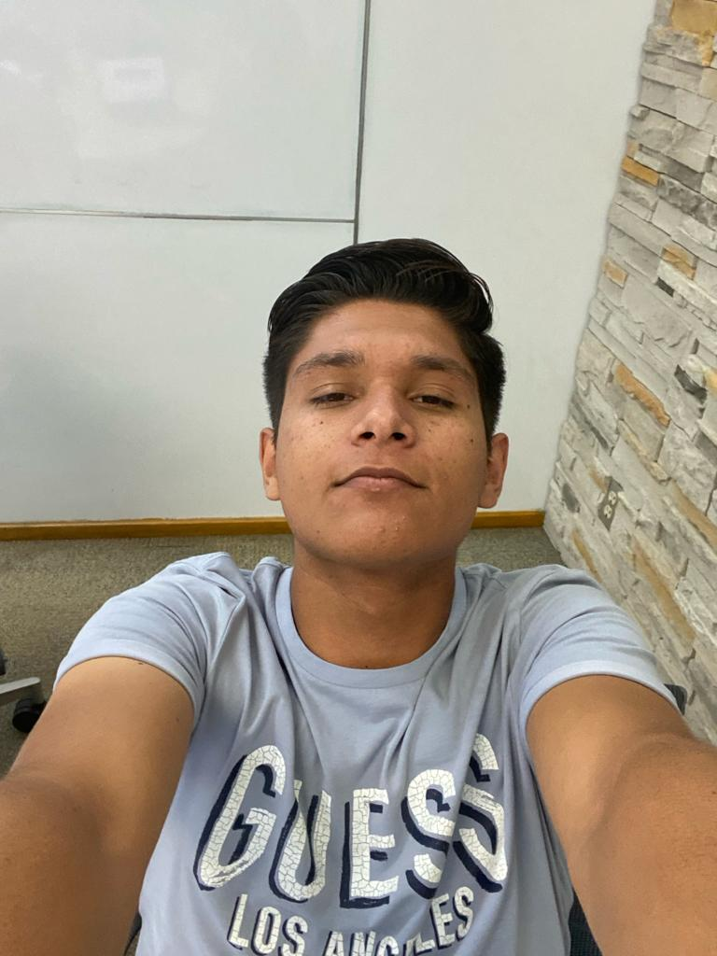
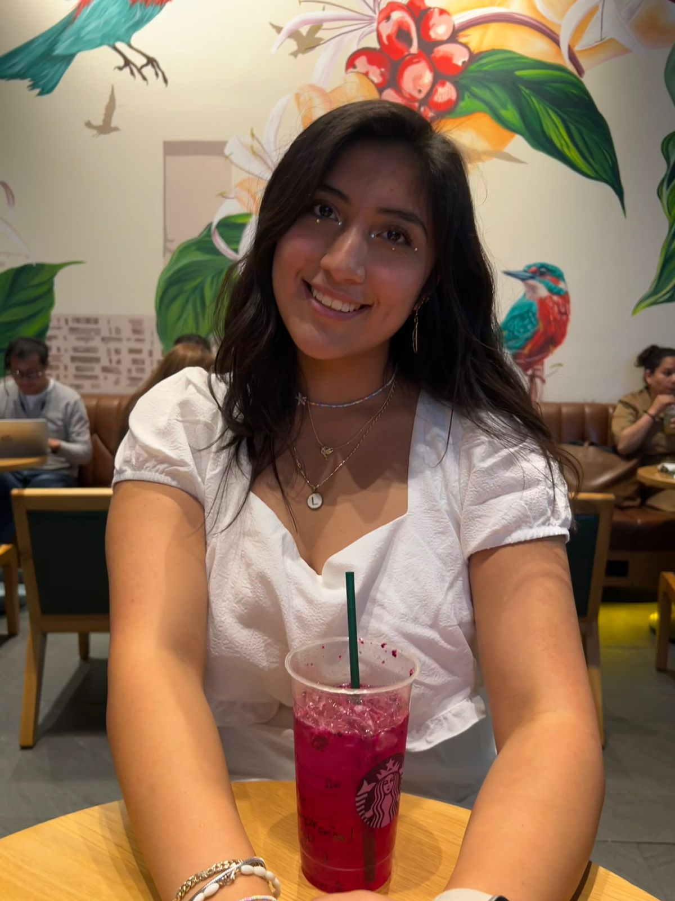
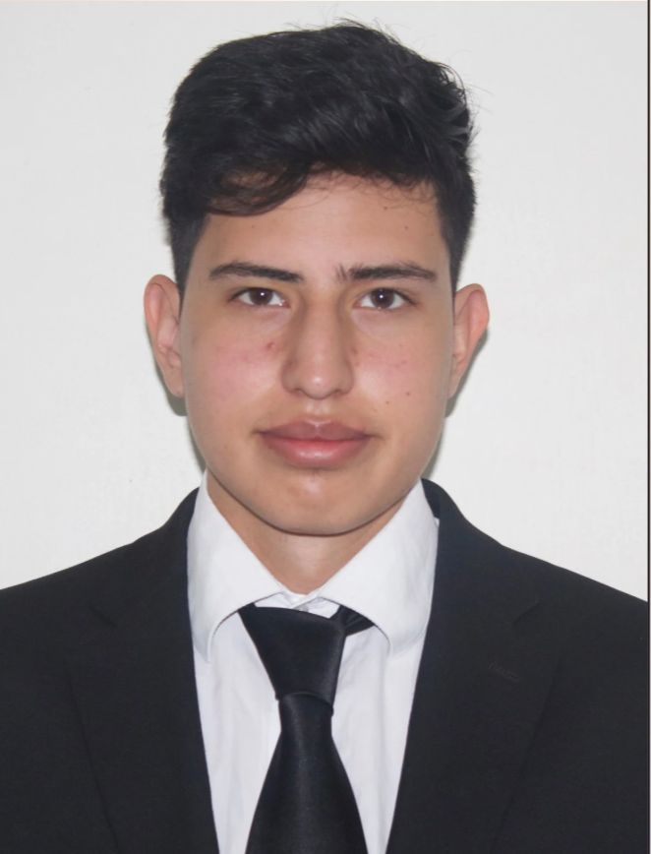
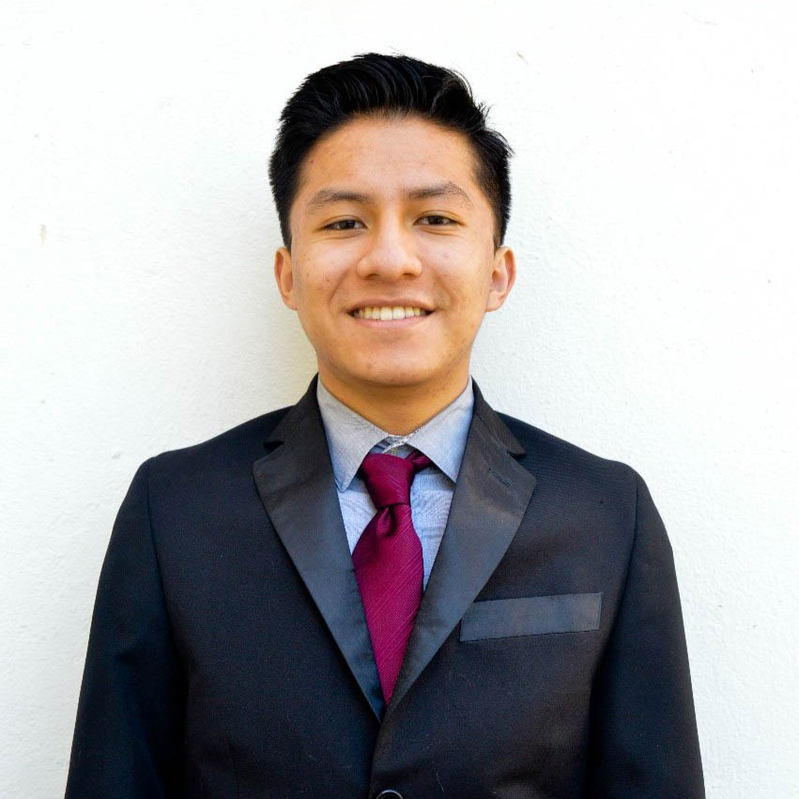

Thank you!
José
Moreno
Lorena
Delgado
Héctor
González
Alfredo
Azamar
Bernardo Limón
Maximiliano
Lecona
Karla
Cruz
Joahan
García
Benjamín Cruz
Eric
Navarro

